Slide 1

Predicting Employee Attrition
Putri Khalilah Binti Kamaluddin

Slide 2

Contents
Introduction
The process of data analysis
Finding on univariate analysis
Finding on multivariate analysis
Performance of the Model
Recommendation

Slide 3


Introduction
Attrition is the decrease in the number of employees over time as they leave due to personal reason or retire.
The objective of this project is to predict the attrition rate for each employee, to find out who’s more likely to leave the organization.
To find possible reasons for employee attrition, in order to avoid valuable employee from leaving.

Slide 4
The Process Of Data Analysis
Data Preparation
Check for missing values
Check for duplicates
Data Pre-Processing
Understand how the features are related to our target variable – Attrition
Feature engineering and Partitioning
Apply feature selection and feature engineering to make it model ready
Apply Algorithm's to check which is the most suitable
Train Algorithm
Model Evaluation and Recommendation
Draw out recommendations based on analysis
Logistic Regression
Naïve Beyes Thereom

Slide 5
Finding of Univariate Analysis
Attrition proportion
Age distribution
Years at the Company distribution
Overtime proportion

Slide 6
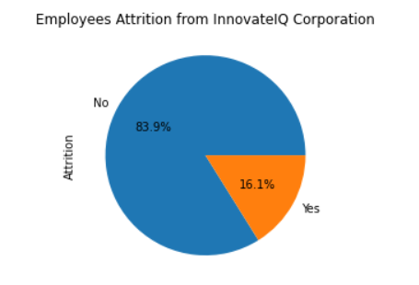
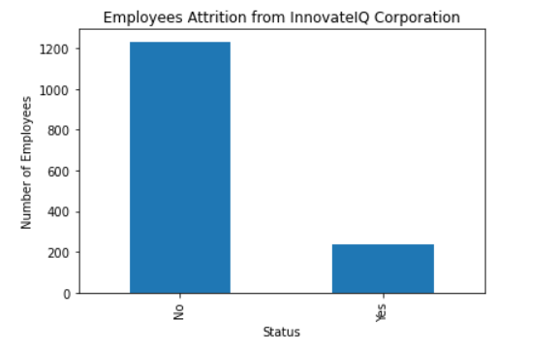
Finding For Attrition
Finding For Attrition:
The data for attrition shows about 84% of their client are still working in the company. While about 16% left the organization. However, the class proportion is imbalanced.
Imbalanced classes distribution for the target value will cause bias or misleading finding for the model accuracy.
This data will be treated before partitioning process.

Slide 7
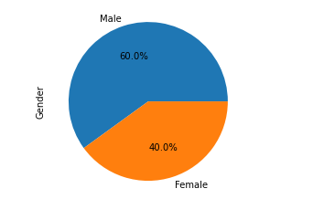
Finding For Gender
Finding For Gender:
The data for gender shows that 60% of their employees are male and 40% are female regardless their attrition status.

Slide 8
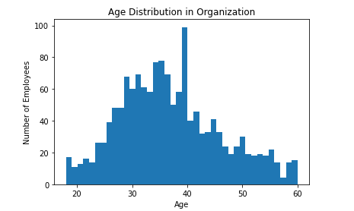
Finding For Age
Finding For Age:
The age distribution shows highest between age group of 30-40 years old. At this age group, people are trying to get comfortable.
This organization have age variances between Millennials (20s) and Generation X(60s).

Slide 9
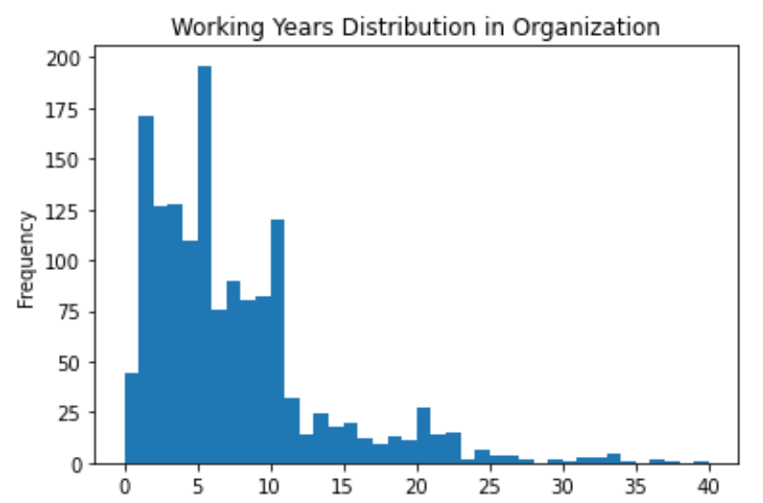
Finding For Years at Company
Finding For Years at Company:
The employees working years distribution shows highest between 5-10 years old of working experiences.
This organization constitutes of long-term employment ranging from five to 10 years.
Probably the company provide benefits.

Slide 10
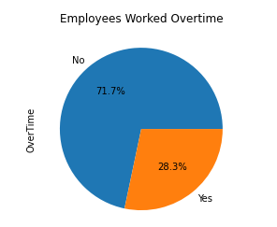
Finding For Overtime
Finding For Overtime:
Almost 30% employees who worked overtime in the company.
Not practicing work-life balance.
Likely make employees burnout.

Slide 11
Finding of Multivariate Analysis
Attrition vs Gender
Attrition vs Age
Attrition vs Monthly Income
Attrition vs Years at the Company?
Attrition vs Job Satisfaction & Environment Satisfaction
Attrition vs Overtime

Slide 12
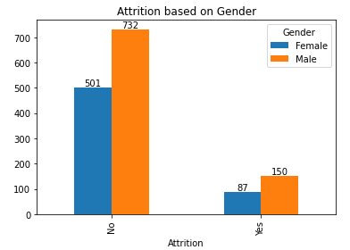
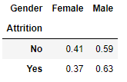
Finding For Attrition vs Gender
Finding For Attrition vs Gender:
P-value obtained from the chi square test is 0.291 (> 0.05), meaning Gender is not significantly difference between Male and Female.
The ratios in our data are the same. Gender isn't a strong determinant of an employee leaving the company.

Slide 13
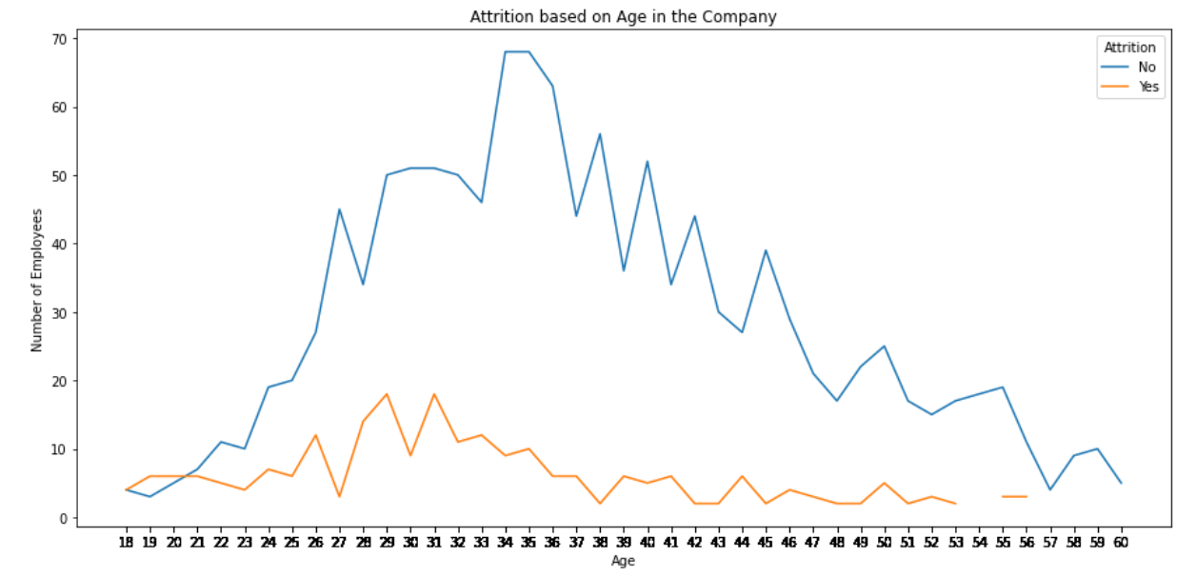

Finding For Attrition vs Age
Finding For Attrition vs Age:
The attrition is maximum between the age groups 28-32 years old.
The independent t-test is 8.356e-10 (<0.05), meaning Age is significantly affecting the attrition rate.
Chances younger people tend to leave the company is far more as they are still exploring at this point of time.
Although, the number of people leaving the company keeps on falling as age increase.
Older people, tend to keep working in the same company as they are looking for stability at these point of times.

Slide 14
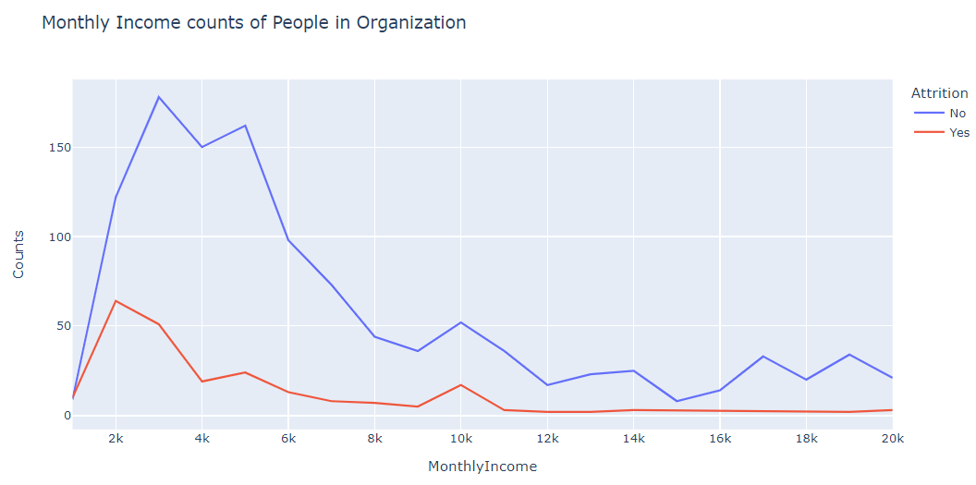
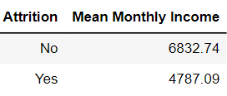
Finding For Attrition vs Monthly Income
Finding For Attrition vs Monthly Income:
P-value obtained from the independent t- test is 4.335e-13 (< 0.05), meaning Monthly Income is significantly affecting attrition rate.
Based on mean monthly income, higher salary is commonly motivating people to keep working in the same company.

Slide 15
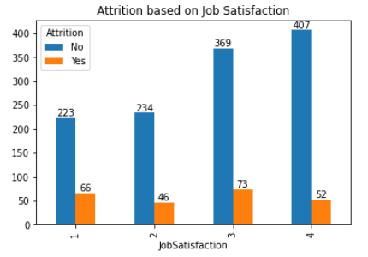
Finding For Attrition vs Job Satisfaction
Finding For Attrition vs Job Satisfaction:
P-value obtained from the chi square test is 0.000556 (< 0.05), meaning Job Satisfaction is slightly affecting the attrition rate.
There is a change the company to improve and do better to retain the employees.

Slide 16
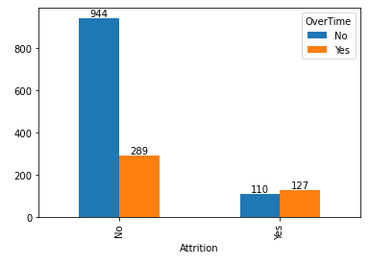
Finding For Attrition vs Over Time
Finding For Attrition vs OverTime:
P-value obtained from the chi square test is 8.16e-21 (< 0.05), meaning OverTime is significantly affecting the attrition rate.
Employees are likely to leave the company when they were working overtime.
Although working overtime can boost their paychecks, overworked employee may start to have feelings of stress and frustration, eventually will affect their work performances.

Slide 17
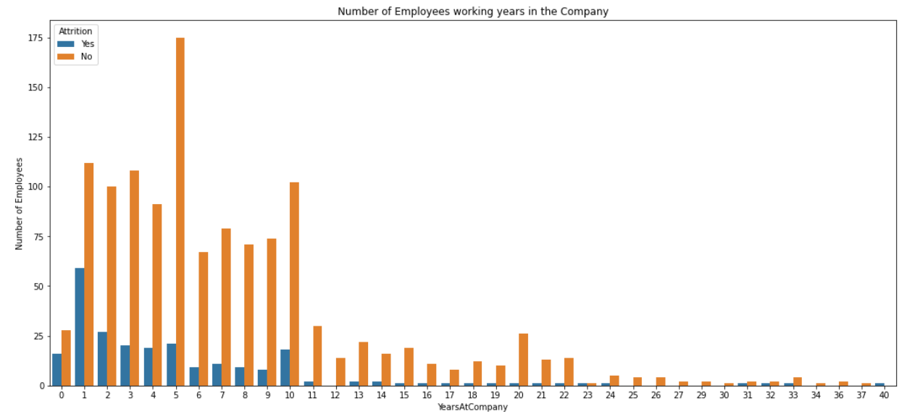
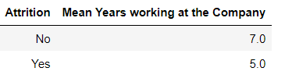
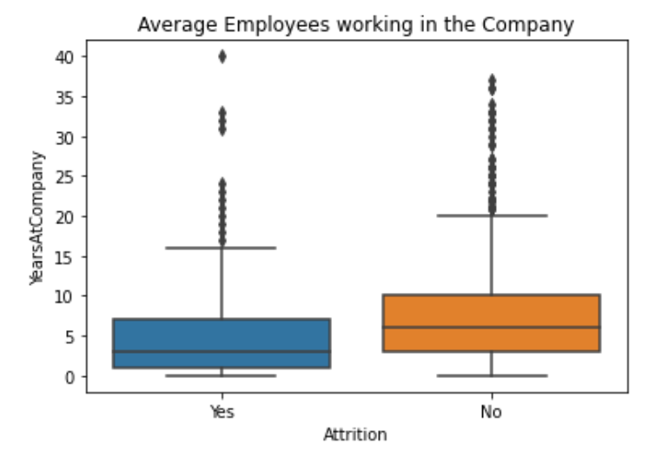
Finding For Attrition vs Years at Company
Finding For Attrition vs YearsAtCompany:
P-value obtained from the independent t-test is 2.318e-7 (< 0.05), meaning YearsAtCompany is significantly affecting the attrition rate.
Employees in their early years of career tend to resign a lot more than employees who've worked in the company.
Average employees who are not leaving the company has worked about 7 years.

Slide 18
Perform the Modelling
Check for multicollinearity between input variables
Feature Engineering
Feature Selection
Feature Transforming
Partitioning
Feature Scaling
Train the model
Logistic Regression
Naïve Beyes Theorem

Slide 19
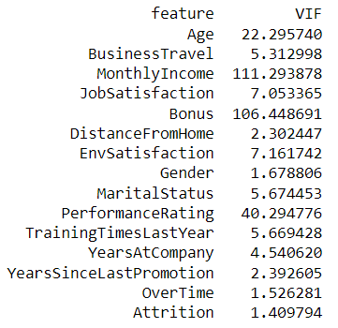
Check for multicollinearity between input variables.
Multicollinearity in the dataset:
Multicollinearity: Occurrence of intercorrelations between two or more independent variables.
When using Logistic Regression, we need to consider, Independent/predictor variables must have little to no collinearity amongst them meaning that they should be independent of each other.
Check using Variance Inflation Factor (VIF).
Depends on case usage, if the VIF score above 10, its better to remove one of the correlated independent variables to avoid model’s performance interpretability.

Slide 20
Feature Engineering a) Feature Selection
Input variables to consider for the modelling:
'Age’
'BusinessTravel’
'JobSatisfaction’,
'DistanceFromHome’,
'EnvSatisfaction’,
'Gender’,
'MaritalStatus',
'TrainingTimesLastYear’,
'YearsAtCompany',
'YearsSinceLastPromotion’,
'OverTime’

Slide 21
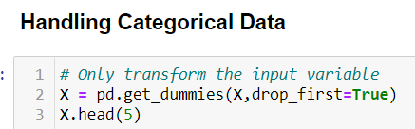
Feature Engineering b) Feature Transforming
Handling Categorical variables:
Why do we convert categorical variables to numeric?
Machine Learning Models can not work on categorical variables in the form of strings, so we need to change it into numerical form.
'BusinessTravel’
'Gender’,
'MaritalStatus',
'OverTime’
Apply pandas get.dummies() function to encode this string to numeric.
Be mindful, only transform the input variables!
Before
After
OverTime
Yes
No
Yes
No
OverTime_Yes
1
0
1
0

Slide 22
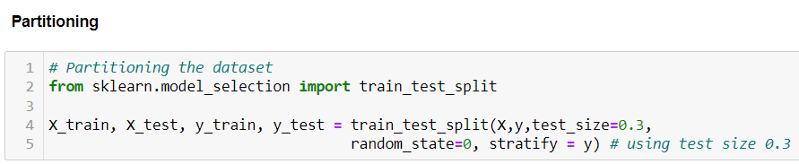
Feature Engineering c) Partitioning
Overall | No | Yes
 | 1233 | 237
Partitioning the data:
Need to assign the dataset in X and y input.
Apply train_test_split from sklearn package library.
Remember our dataset is imbalanced?
Imbalance classes distribution for the response value will cause bias.
Stratified sampling will distribute the data point evenly (maintaining the ratio) according to the proportion of the classes.
Train Set 70% | No | Yes
 | 863 | 166
Test Set 30% | No | Yes
 | 370 | 71

Slide 23
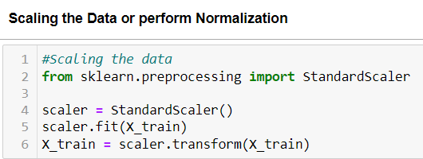
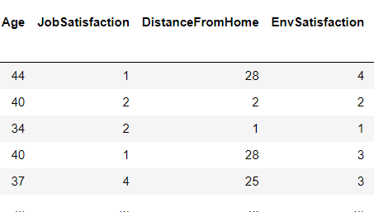
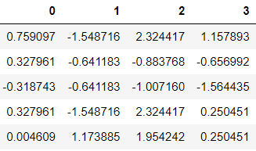
Feature Engineering d) Feature Scaling
Normalization in Machine Learning:
Why do we scale data in machine learning?
As our input variables are in different value range, the feature with a higher value range starts dominating our calculation and this will lead to misleading model interpretation.
Apply StandardScaler from sklearn package library to help normalize or scaling the data.

Slide 24
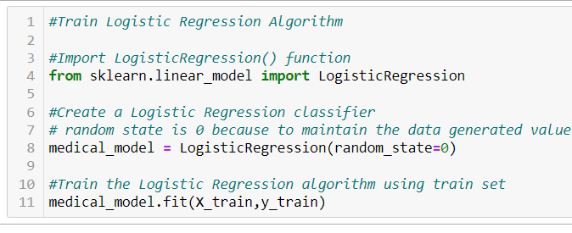
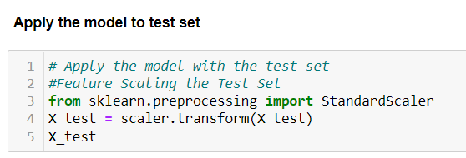
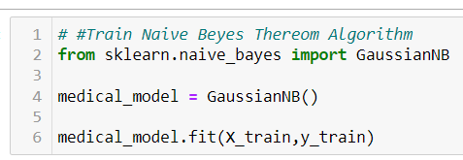

Train the model
Logistic Regression
Naïve Beyes Theorem

Slide 25
Evaluation
Model Performance
Recommendation for the company

Slide 26
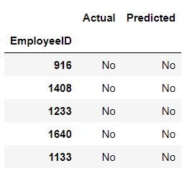
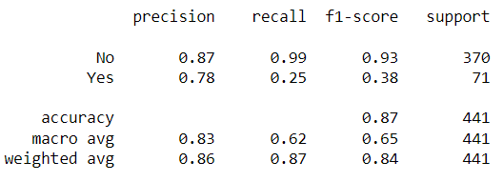
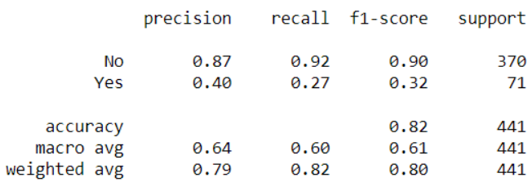
Model Performance
Predicted Output and Actual Output
Performance Evaluation
Logistic Regression
Overall accuracy – 87%
Performance Evaluation
Naïve Beyes
Overall accuracy – 82%
Conclusion: Logistic Regression is better model to predict the attrition rate.

Slide 27
Recommendation for the company
Provide incentive for those who work overtime or practice a work-life balance in the organization.
Fairly pay employees in same job level, same job involvement with almost equal monthly income.
Provide benefits to the younger employees such as flexible working environments and schedules or communicate opportunities for career progression.

Slide 28
THANK YOU!
Putri Khalilah Binti Kamaluddin

